Slide 1
INDUSTRIAL HUMAN RESOURCE GEO - VISUALIZATION
PREDICTIVE ANALYSIS AND GEO – VISUALIZATION OF HUMAN RESOURCE DATA

Slide 2

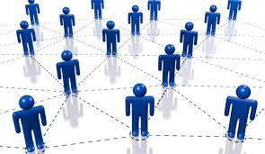
INDUSTRIAL HUMAN RESOURCE
AGENDA :
1.Introduction
2.Objective
3.Tools
4.Approach
5.EDA – Exploratory Data Analysis
6.NLP Analysis

Slide 3

Human Resource Management

Slide 4
INTRODUCTION
Problem Statement :
In India, the industrial classification of the workforce is crucial to understand labour distribution across sectors.
Current data on main and marginal workers is outdated and may not reflect the current state of the workforce
The aim of the study is to provide accurate data for policy making and employment planning

Slide 5
OBJECTIVE
Objective :
“Update industrial classification of main and marginal workers based on sex and
Section, division and class”.
Significance :
“Accurate data on workforce classification helps in making informed policy decisions and employment planning”.

Slide 6
TOOLS
Technologies and Tools :
Python as the programming language.
Streamlit for web application.
Pandas for data manipulation.
Matplotlib and Folium for data visualization

Slide 7
APPROACH
Project Workflow :
Data Loading : Use of pandas to load human resource data from CSV.
Preprocessing : Clean and Preprocess data, include splitting column.
Data Exploration : Explore data using St for user – friendly interaction.
Geo-Visualization : Utilize Folium to create an interactive map for human resource distribution.

Slide 8


Slide 9
EDA – Exploratory Data Analysis
SELECT ME
Key Findings :
Total no of state workers(Main & Marginal)
Distribution of workers in rural, main and urban areas.
Male female ratios among workers.
Visualization of marginal workers in rural and urban areas.

Slide 10
NLP ANALYSIS
Main Workers Marginal workers different and Rural and Urban workers.
Various NICName sectors.

Slide 11
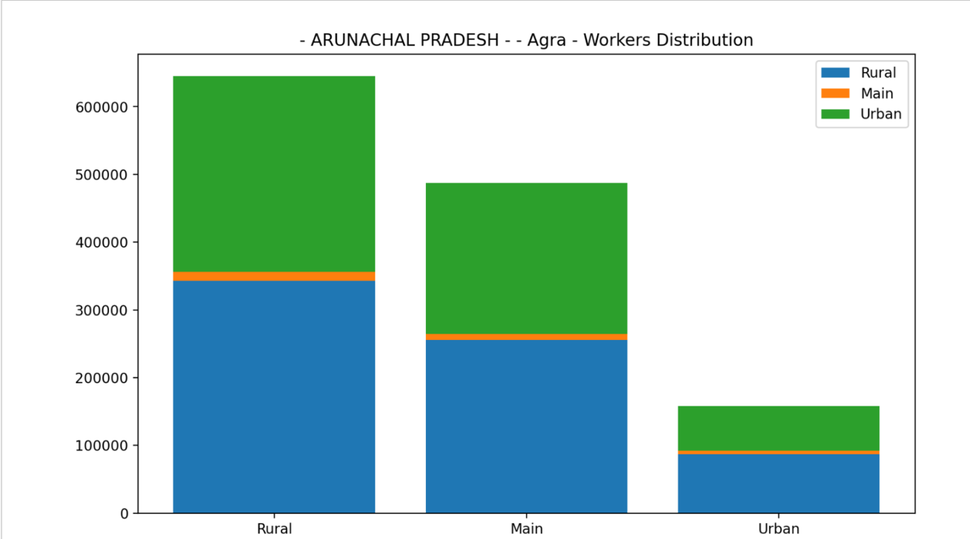

Slide 12
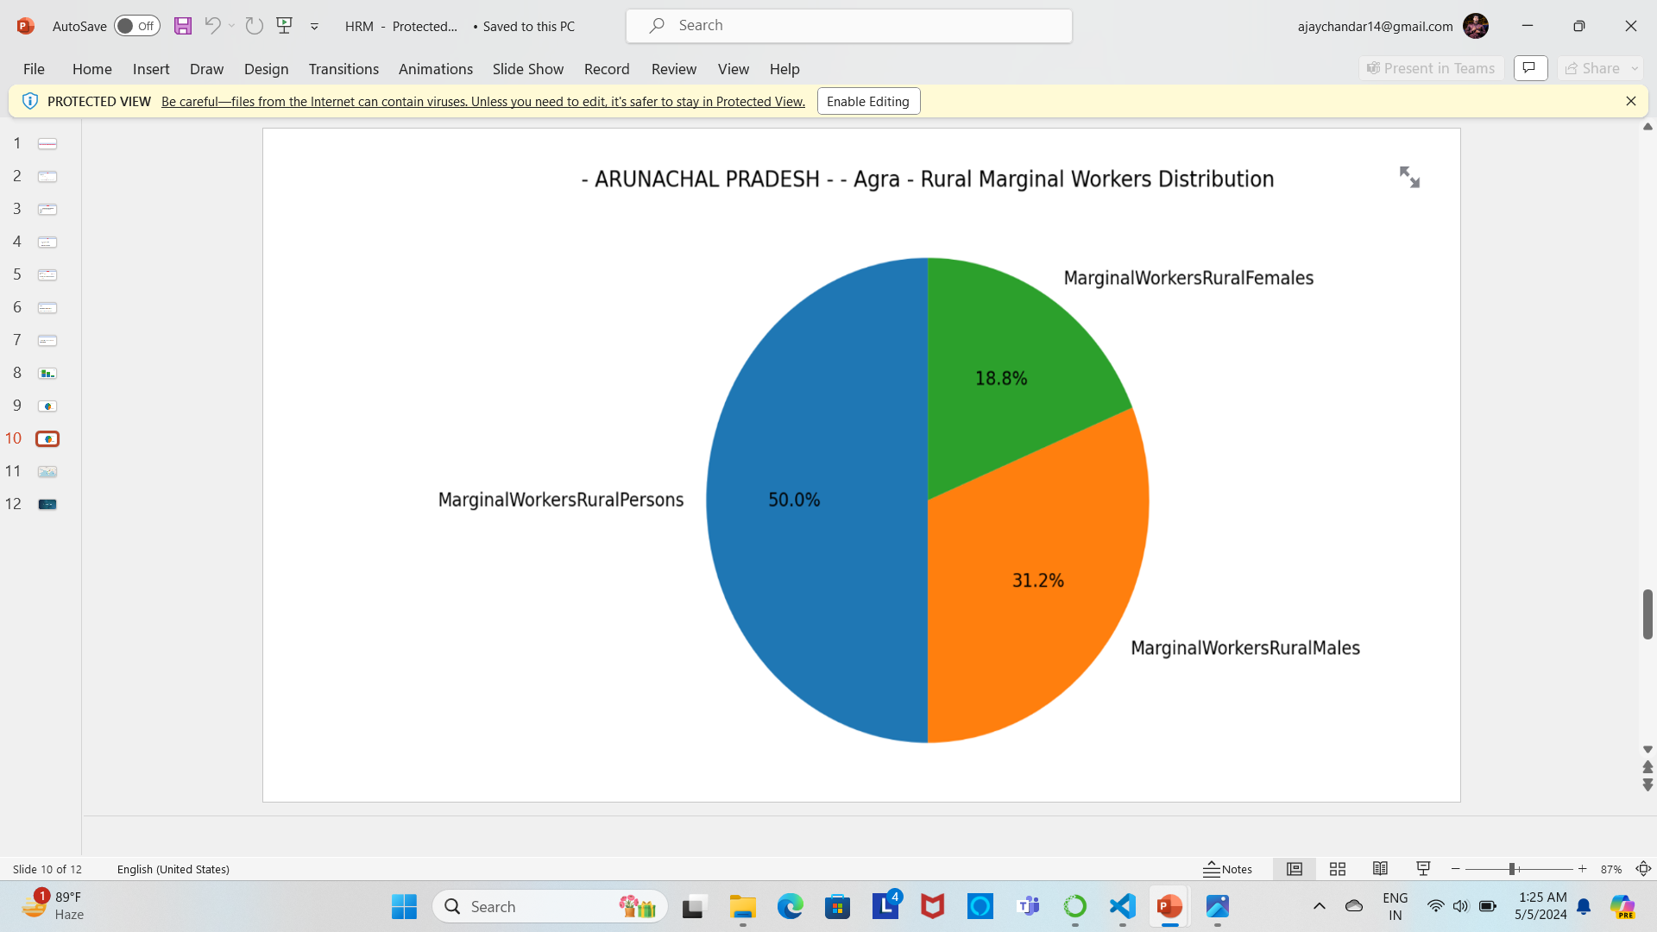
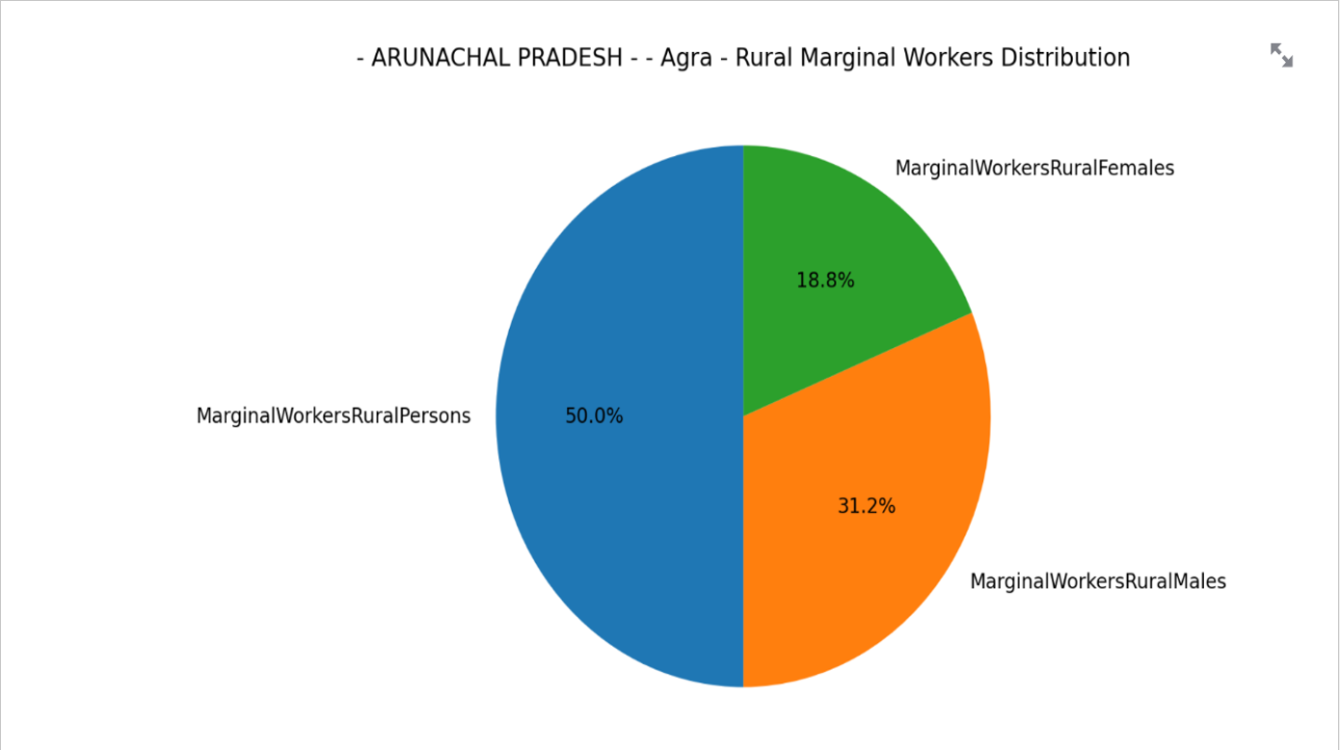

Slide 13
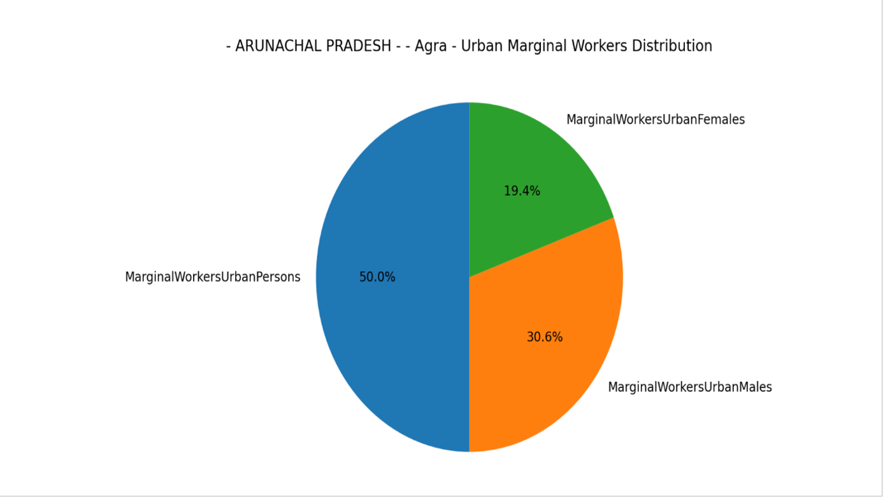

Slide 14
THANK YOU

